Slide 1
Third Programme for the Union’s action in the field of Health (2014-2020) INFO DAY
Wednesday 9th July 2014,
10:30 am – 13:20 pm School of Public Health “Andrija Štampar”

Slide 2
AIM of the Info Day
Present the audience with the new programmes under the European Commission’s Consumers, Health and Food Executive Agency (CHAFEA)
(Focus: New Rules & Application procedure)
Present the best practices from previous programmes (PARENT and RARHA JA)

Slide 3
CHAFEA Presenters
Ana Mancho Rojo,
Project Officer, European Commission, Consumers, Health and Food Executive Agency (CHAFEA)
Dimitri Agneskis,
Financial officer, European Commission, Consumers, Health and Food Executive Agency (CHAFEA)

Slide 4
Info Day AGENDA
10:00 Registration
10:30 Opening Session
Vanja Pajić, Croatian National Institute of Public Health (HZJZ), National Focal Point for Public Health Programme
10:40 Welcome
Dunja Skoko-Poljak, Ministry of Health
10:50 Overview of the Third Programme for the Union’s action in the field of Health (2014- 2020) and Work Programme for 2014 with a focus on the new submission procedure
Ana Mancho Rojo, Project Officer, European Commission, Consumers, Health and Food Executive Agency (CHAFEA)
Principles of the financial management under the Call for Proposals 2014.
Dimitri Agneskis, Financial officer, European Commission, Consumers, Health and Food Executive Agency (CHAFEA)
12:30 Break
12:45 Advice from a successful participant - PARENT & RARHA Joint Action Projects,
Iva Pejnović Franelić, Martina Jelinić & Vanja Pajić, Croatian National Institute of Public Health (HZJZ)
13:20 Q&A
13:30 Closing Session
Vanja Pajić, Croatian National Institute of Public Health (HZJZ), National Focal Point for Public Health Programme

Slide 5
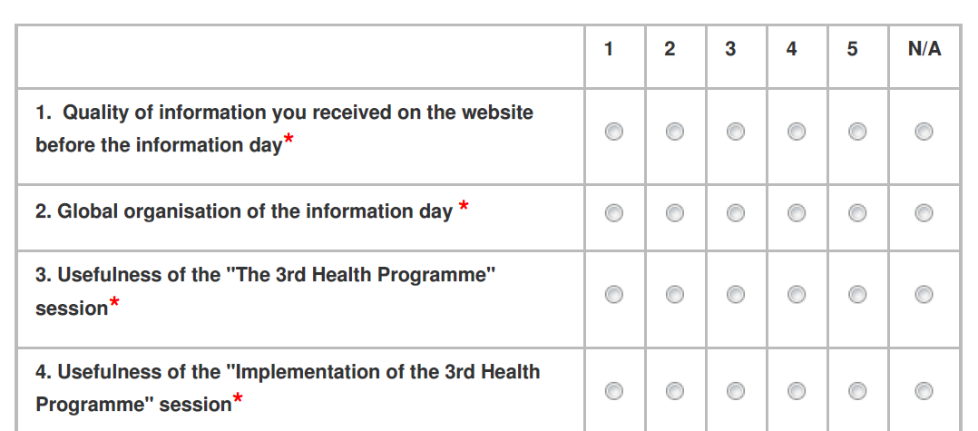
Attendance SATISFACTION SURVEY
We would appreciate, if you could take some time to tell us your opinion about the event.

Slide 6
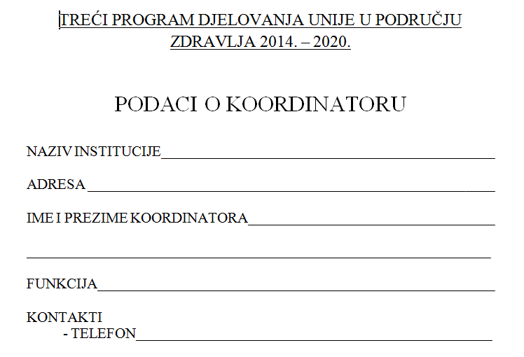
Local Focal Point
The aim of the focal point is to coordinate CHAFEA activities within the institution and have a close communication with the National Focal Point

Slide 7
Where to go from here?
Contacts with your National Focal Point
Contacts with your Local Focal Point
CHAFEA and HORIZON2020 web portals
Monthly meetings/workshops on project proposals?
Info days

Slide 8
Kako do pomoći?
Za više informacija o financiranju projekata u području zdravstva i drugim mogućnostima financiranja posjetite internetsku stranicu Izvršne agencije za potrošače, zdravlje i hranu na adresi:
http://ec.europa.eu/chafea/health/
ili se obratite odjelu za pomoć putem e-pošte na
CHAFEA-HP-CALLS@ec.europa.eu
ili nazovite broj telefona (+352) 4301 37707.
Nacionalna kontakt točka za Treće programe Zajednice
Vanja Pajić, Hrvatski zavod za javno zdravstvo
vanja.pajic@hzjz.hr
Martina Jelinić, Hrvatski zavod za javno zdravstvo
martina.jelinic@hzjz.hr
Nacionalni koordinator za Treće programe Zajednice
Dunja Skoko-Poljak, Ministarstvo zdravlja RH
dunja.skoko-poljak@miz.hr

